Slide 1


Slide 2

Introduction to Data Analyst and Data Science for Beginners Lecture # 4 String Data Structure in Python
Ehtisham Sadiq

Slide 3

Today’s Agenda
Recap of Previous Lecture
What is Data Structure (Data Types) and String Data Structure
Defining Strings in the Python
Accessing characters of a String (Indexing)
Strings are immutable(Reassigning String)
Strings Slicing
String Concatenation
Create large Strings
Operations on string Data structure
Strings method
lower(), upper(), strip(), startswith(), endswith(), split(), join(), find(), replace(), format(), len(), min(), max(), sorted(), title()/capitalize, swapcase(), count(), find(), index(), isalnum() / isalpha(), isdigit(),
String Deletion
String Membership test

Slide 4
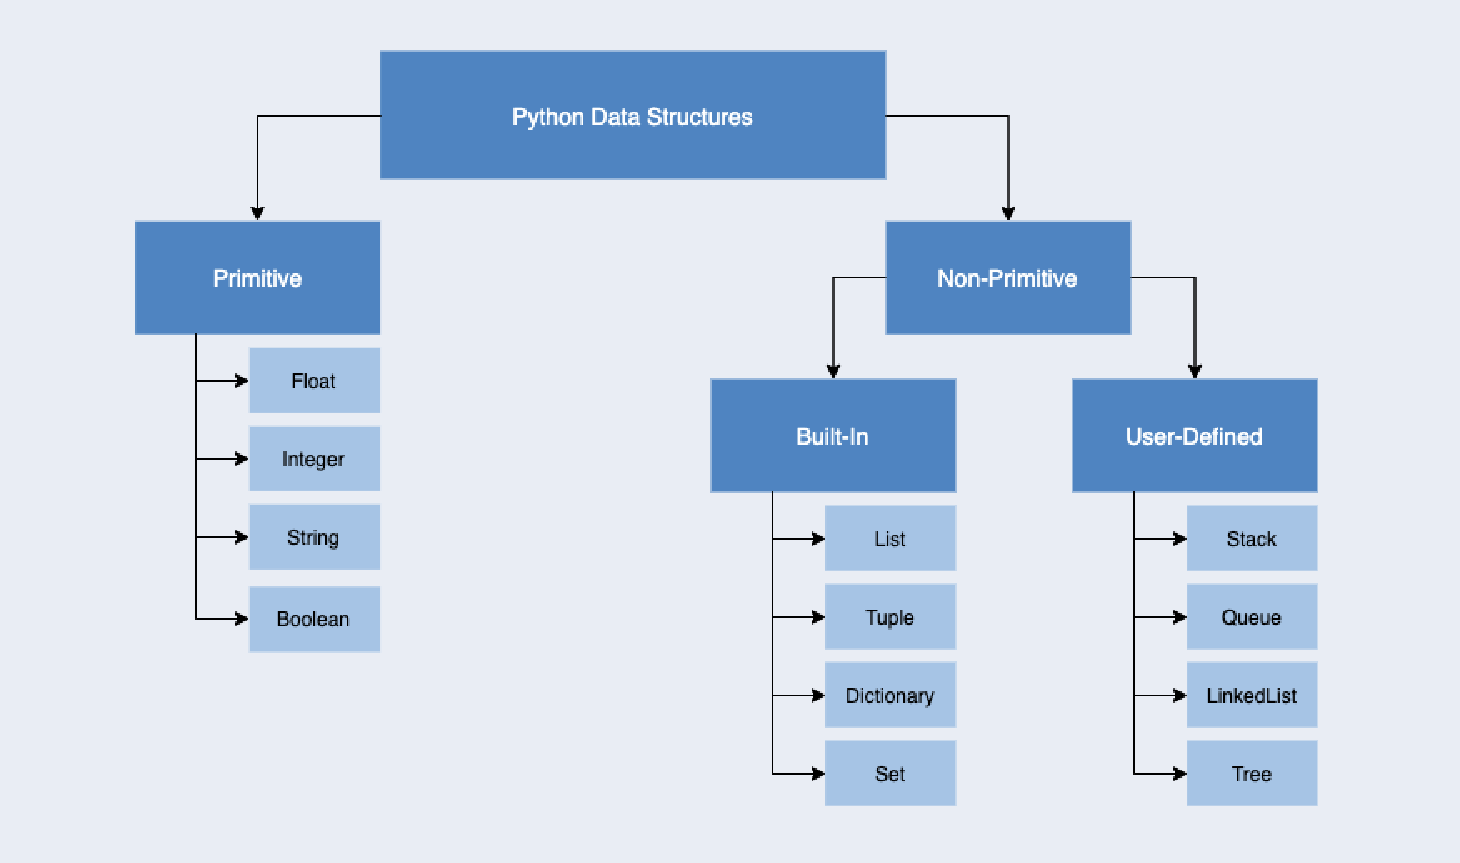
What is Data Structure ?
Data structure is a particular way of storing and organizing data in a computer so that it can be used efficiently. A data structure is a special format for organizing and storing data .

Slide 5
String Data Structure

Slide 6

Any Question?

